Slide 1
Substance
Prof Dr Ramli Musa
www.ramlimusa.com

Slide 2
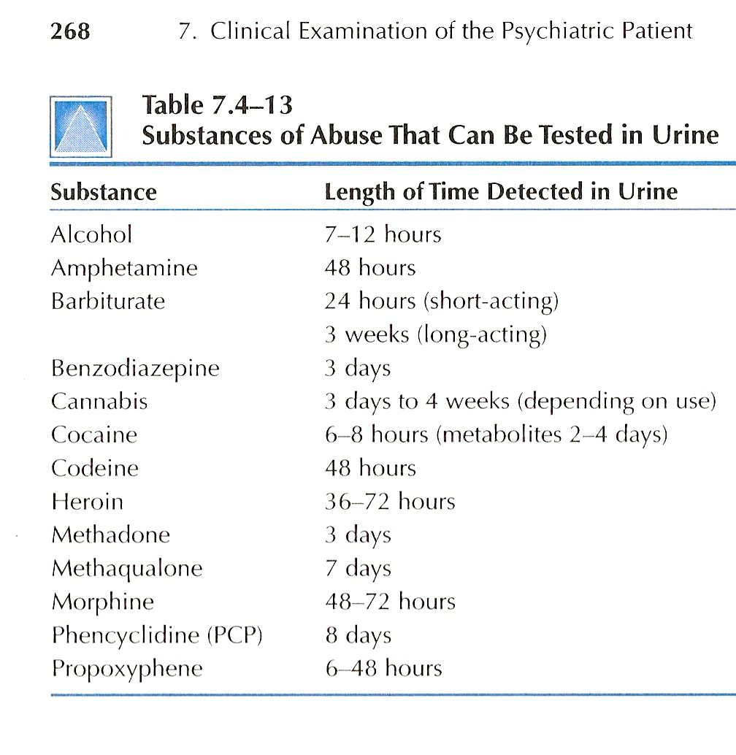

Slide 3
